Slide 1
Introduction of Reinforcement Learning
Notes:
Introduction of Reinforcement Learning 强化学习简介
Scratching the surface 浅显易懂，学一些皮毛

Slide 2


Deep Reinforcement Learning
Notes:
https://deepmind.com/research/dqn/

Slide 3
Reference
Textbook: Reinforcement Learning: An Introduction
http://incompleteideas.net/sutton/book/the-book.html
Lectures of David Silver
http://www0.cs.ucl.ac.uk/staff/D.Silver/web/Teaching.html (10 lectures, around 1:30 each)
http://videolectures.net/rldm2015_silver_reinforcement_learning/ (Deep Reinforcement Learning )
Lectures of John Schulman
https://youtu.be/aUrX-rP_ss4
Notes:
John Schulman: open AI

Slide 4

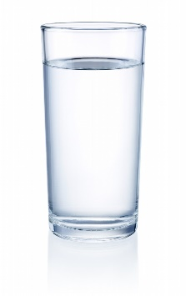


Scenario of Reinforcement Learning
Observation
Action
State
Change the environment
Agent
Don’t do that
Reward
Environment
Notes:
Scenario of Reinforcement Learning 强化学习的场景
Observation 观察
Reward 报酬

Slide 5

Scenario of Reinforcement Learning
Agent learns to take actions maximizing expected reward.
Observation
Action
State
Change the environment
Agent
Thank you.
Reward
https://yoast.com/how-to-clean-site-structure/
Environment
Notes:
Agent learns to take actions maximizing expected reward. 代理学习采取行动来最大化预期回报。

Slide 6
Machine Learning ≈ Looking for a Function
Actor/Policy
Observation
Action
Action = π( Observation )
Function input
Function
output
Used to pick the best function
Reward
Environment
Notes:
Actor/Policy 参与者/政策

Slide 7
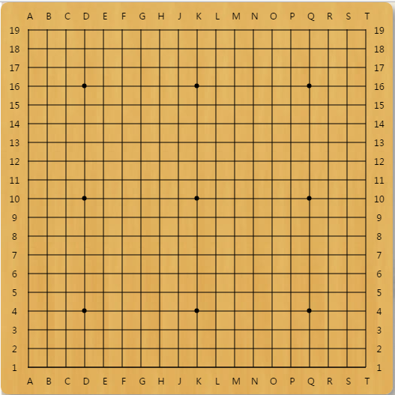

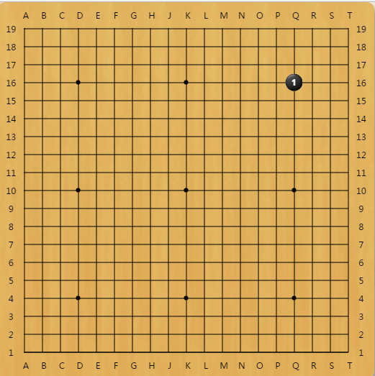
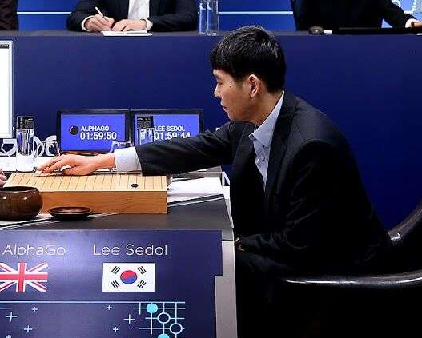
Learning to play Go
Observation
Action
Reward
Next Move
Environment

Slide 8
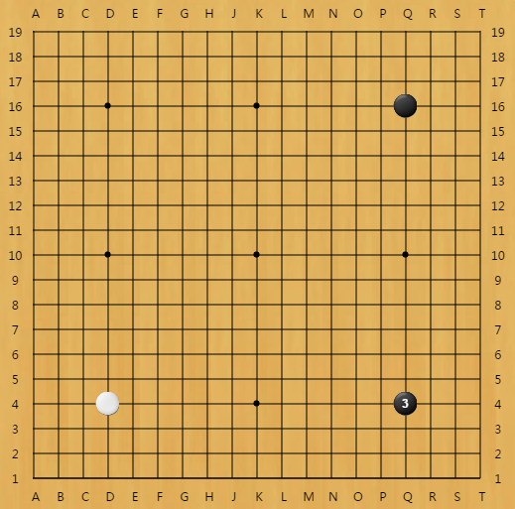
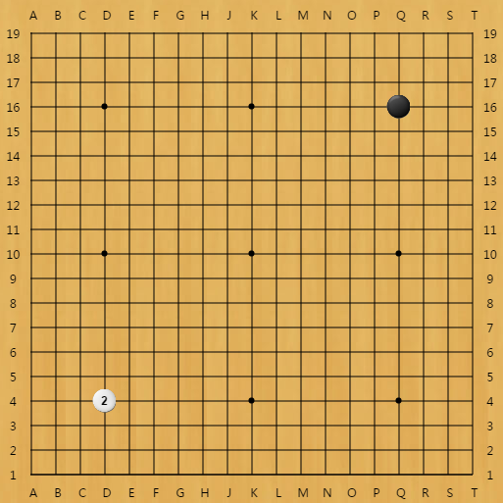
Learning to play Go
Agent learns to take actions maximizing expected reward.
Observation
Action
Reward
reward = 0 in most cases
If win, reward = 1
If loss, reward = -1
Environment

Slide 9
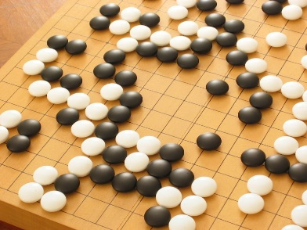
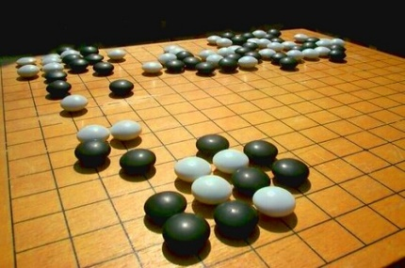
Learning to play Go
Learning from teacher
Supervised:
Reinforcement Learning
Next move:
“5-5”
Next move:
“3-3”
Learning from experience
First move
…… many moves ……
Win!
(Two agents play with each other.)
Alpha Go is supervised learning + reinforcement learning.
Notes:
Supervised 学习下围棋的过程就是告诉机器当你看到什么残势的时候下一步下在哪里，但是有时候人或者棋谱也不知道下一步要下在哪里，所以告诉机器下一步下在哪里不一定是最好的，只有等到下完围棋决定输赢的时候才知道每一步是否下对，为了解决这个问题，就需要强化学习

Slide 10


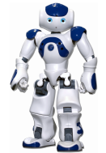


Learning a chat-bot
https://image.freepik.com/free-vector/variety-of-human-avatars_23-2147506285.jpg
http://www.freepik.com/free-vector/variety-of-human-avatars_766615.htm
Machine obtains feedback from user
Chat-bot learns to maximize the expected reward
How are you?
Hello
Bye bye ☺
Hi ☺
-10
3
Notes:
Consider that you have a non-differentiable objective function 假设你有一个不可微的目标函数
This is cost! 这就是成本！
Ignore multiple turns here 此处忽略多个转弯

Slide 11

Learning a chat-bot
Let two agents talk to each other (sometimes generate good dialogue, sometimes bad)
How old are you?
How old are you?
See you.
I am 16.
See you.
I though you were 12.
See you.
What make you think so?
Notes:
sometimes generate good dialogue, sometimes bad 有时会产生好的对话，有时会产生坏的对话

Slide 12


Learning a chat-bot
By this approach, we can generate a lot of dialogues.
Use some pre-defined rules to evaluate the goodness of a dialogue
Dialogue 1
Dialogue 2
Dialogue 3
Dialogue 4
Dialogue 5
Dialogue 6
Dialogue 7
Dialogue 8
Machine learns from the evaluation
Deep Reinforcement Learning for Dialogue Generation https://arxiv.org/pdf/1606.01541v3.pdf
Notes:
By this approach, we can generate a lot of dialogues. 通过这种方法，我们可以生成大量对话。
Use some pre-defined rules to evaluate the goodness of a dialogue 使用一些预定义的规则来评估对话的好坏

Slide 13


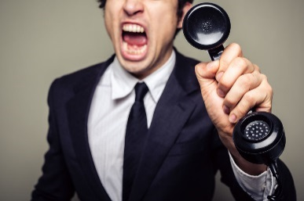
Learning a chat-bot
Supervised
Reinforcement
“Hello”
Say “Hi”
“Bye bye”
Say “Good bye”
…….
…….
……
Hello ☺
……
Bad
Agent
Agent

Slide 14
More applications
Flying Helicopter
https://www.youtube.com/watch?v=0JL04JJjocc
Driving
https://www.youtube.com/watch?v=0xo1Ldx3L5Q
Robot
https://www.youtube.com/watch?v=370cT-OAzzM
Google Cuts Its Giant Electricity Bill With DeepMind-Powered AI
http://www.bloomberg.com/news/articles/2016-07-19/google-cuts-its-giant-electricity-bill-with-deepmind-powered-ai
Text generation
https://www.youtube.com/watch?v=pbQ4qe8EwLo

Slide 15
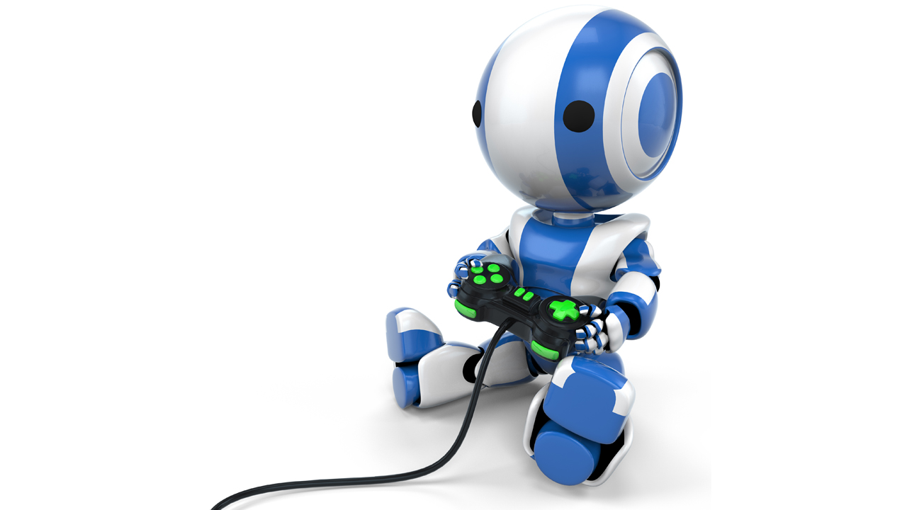
Example: Playing Video Game
Widely studies:
Gym: https://gym.openai.com/
Universe: https://openai.com/blog/universe/
Machine learns to play video games as human players
What machine observes is pixels
Machine learns to take proper action itself

Slide 16
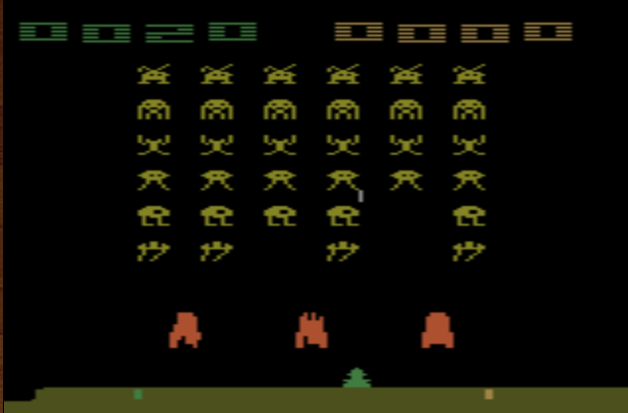
Example: Playing Video Game
Termination: all the aliens are killed, or your spaceship is destroyed.
Space invader
Score (reward)
Kill the aliens
shield
fire

Slide 17
Example: Playing Video Game
Space invader
Play yourself: http://www.2600online.com/spaceinvaders.html
How about machine: https://gym.openai.com/evaluations/eval_Eduozx4HRyqgTCVk9ltw

Slide 18
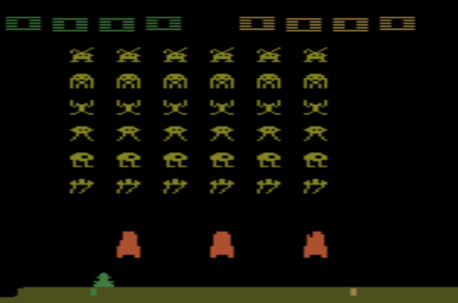
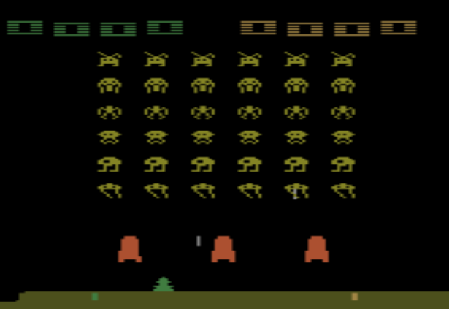
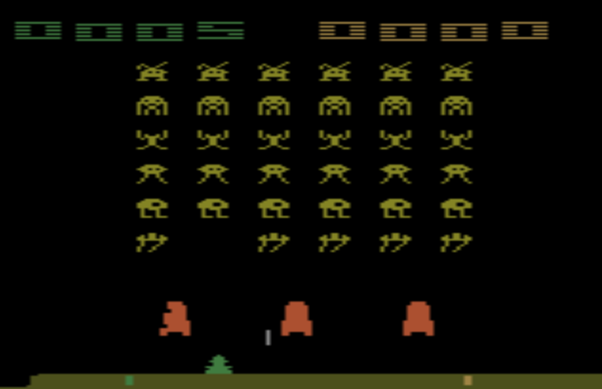
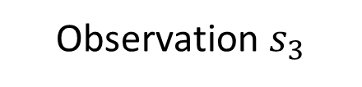
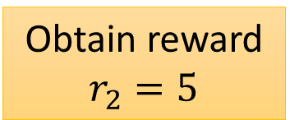
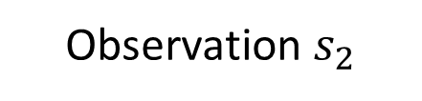
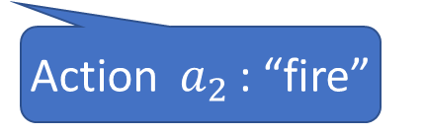
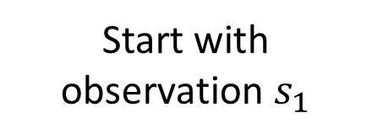
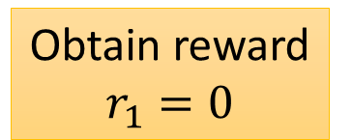
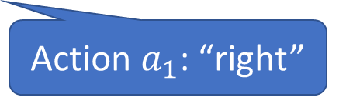
Example: Playing Video Game
Start with observation $s_{1}$
Observation $s_{2}$
Observation $s_{3}$
Obtain reward $r_{1}=0$
Obtain reward $r_{2}=5$
Action $a_{1}$: “right”
Action $a_{2}$: “fire”
(kill an alien)
Usually there is some randomness in the environment

Slide 19
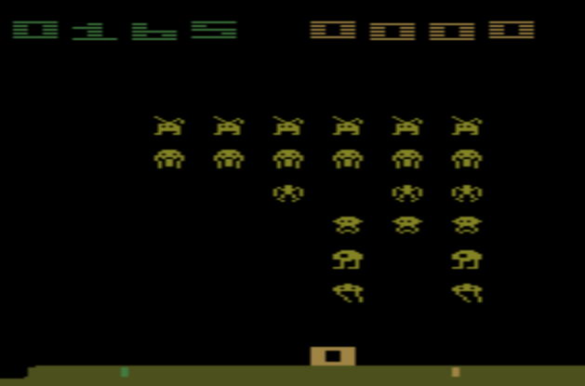
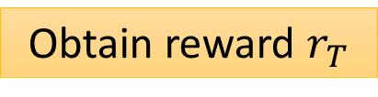
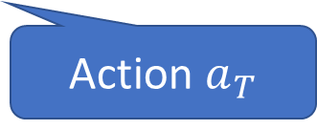
Example: Playing Video Game
Start with observation $s_{1}$
Observation $s_{2}$
Observation $s_{3}$
This is an episode.
After many turns
Game Over
(spaceship destroyed)
Learn to maximize the expected cumulative reward per episode
Obtain reward $r_{T}$
Action $a_{T}$

Slide 20
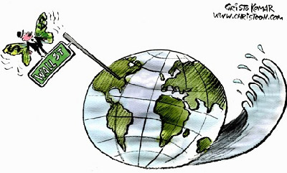
Properties of Reinforcement Learning
Reward delay
In space invader, only “fire” obtains reward
Although the moving before “fire” is important
In Go playing, it may be better to sacrifice immediate reward to gain more long-term reward
Agent’s actions affect the subsequent data it receives
E.g. Exploration
Notes:
Properties of Reinforcement Learning 强化学习的特性
Exploration 探索

Slide 21
Outline
Alpha Go: policy-based + value-based + model-based
Model-free Approach
Policy-based
Value-based
Learning an Actor
Actor + Critic
Learning a Critic
Model-based Approach
Notes:
马尔可夫决策过程 (Markov decision process)
Deep Q Network (DQN)算法
A3C (Asynchronous Advantage Actor-Critic)
Actor 演员
Critic 评论家

Slide 22
Policy-based Approach
Learning an Actor

Slide 23
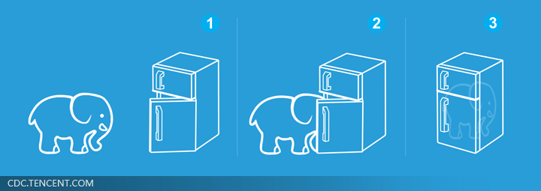
Three Steps for Deep Learning
Step 1: define a set of function
Step 2: goodness of function
Step 3: pick the best function
Neural Network as Actor
Deep Learning is so simple ……
Notes:
http://www.twword.com/wiki/%E8%85%A6%E6%88%B6%E7%A9%B4
http://ukenglish.pixnet.net/blog/post/105691160-%E3%80%90%E5%8F%B0%E5%8D%97%E5%B8%82%E5%AD%B8%E8%8B%B1%E8%AA%9E%EF%BC%8C%E5%84%AA%E9%85%B7%E8%8B%B1%E8%AA%9E%E6%96%87%E7%90%86%E5%85%AC%E5%91%8A%E3%80%91%E6%9C%AC%E4%B8%AD%E5%BF%83
http://onepiece1234567890.blogspot.tw/2013/12/blog-post_8.html

Slide 24
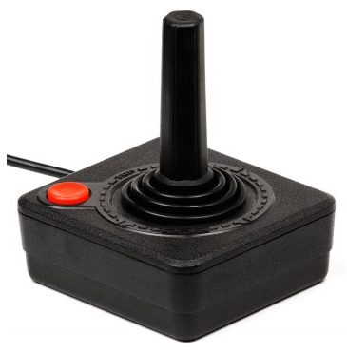
Neural network as Actor
Input of neural network: the observation of machine represented as a vector or a matrix
Output neural network : each action corresponds to a neuron in output layer
NN as actor
left
0.7
Probability of taking the action
…
right
0.2
…
fire
0.1
pixels
What is the benefit of using network instead of lookup table?
generalization
Notes:
Taking the action with the highest score

Slide 25
Three Steps for Deep Learning
Step 1: define a set of function
Step 2: goodness of function
Step 3: pick the best function
Neural Network as Actor
Deep Learning is so simple ……
Notes:
http://www.twword.com/wiki/%E8%85%A6%E6%88%B6%E7%A9%B4
http://ukenglish.pixnet.net/blog/post/105691160-%E3%80%90%E5%8F%B0%E5%8D%97%E5%B8%82%E5%AD%B8%E8%8B%B1%E8%AA%9E%EF%BC%8C%E5%84%AA%E9%85%B7%E8%8B%B1%E8%AA%9E%E6%96%87%E7%90%86%E5%85%AC%E5%91%8A%E3%80%91%E6%9C%AC%E4%B8%AD%E5%BF%83
http://onepiece1234567890.blogspot.tw/2013/12/blog-post_8.html

Slide 26

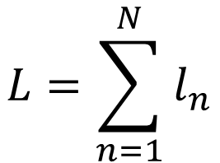
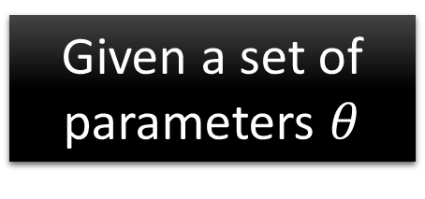
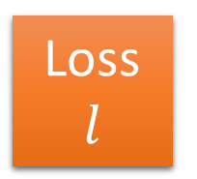
Goodness of Actor
Total Loss:
$$L=\sum_{n=1}^{N}{l_{n}}$$
Review: Supervised learning
Training Example
“1”
……
y₁
1
As close as possible
……
y₂
Given a set of parameters $θ$
0
Softmax
target
……
……
……
……
……
Loss
$$l$$
……
y₁₀
0

Slide 27
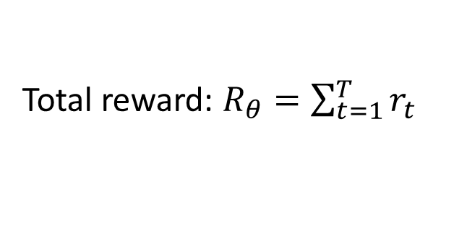
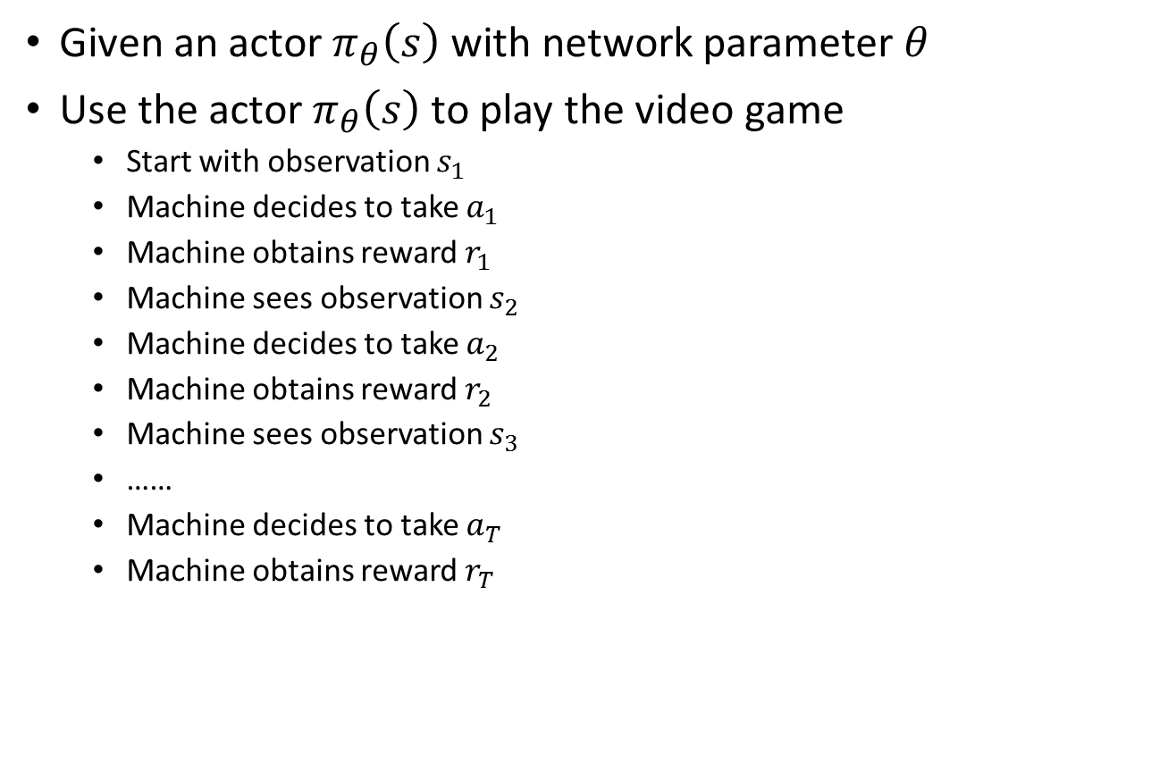
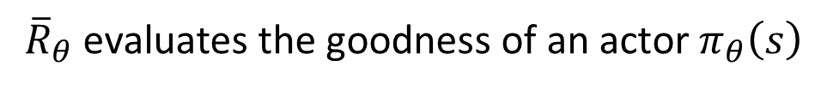
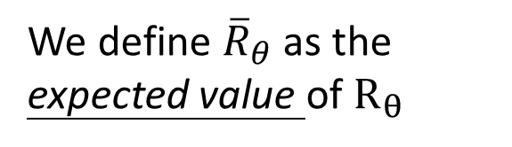
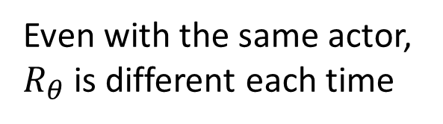
Goodness of Actor
Given an actor $π_{θ}\left(s\right)$ with network parameter $θ$
Use the actor $π_{θ}\left(s\right)$ to play the video game
Start with observation $s_{1}$
Machine decides to take $a_{1}$
Machine obtains reward $r_{1}$
Machine sees observation $s_{2}$
Machine decides to take $a_{2}$
Machine obtains reward $r_{2}$
Machine sees observation $s_{3}$
……
Machine decides to take $a_{T}$
Machine obtains reward $r_{T}$
Total reward: $R_{θ}=\sum_{t=1}^{T}{r_{t}}$
Even with the same actor, $R_{θ}$ is different each time
Randomness in the actor and the game
We define ${\overline{R}}_{θ}$ as the expected value of $R_{θ}$
END
${\overline{R}}_{θ}$ evaluates the goodness of an actor $π_{θ}\left(s\right)$

Slide 28
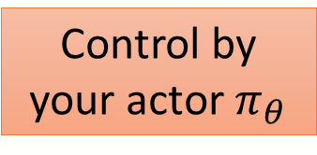
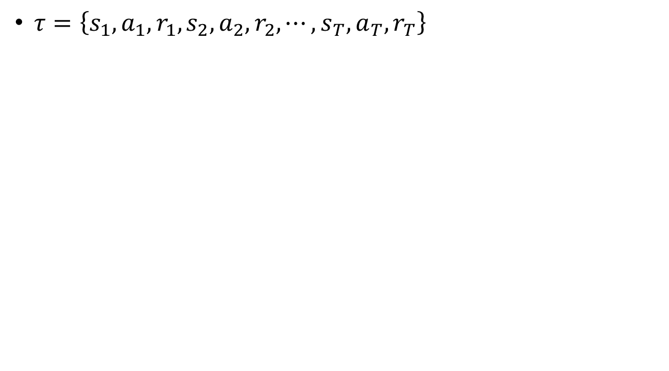
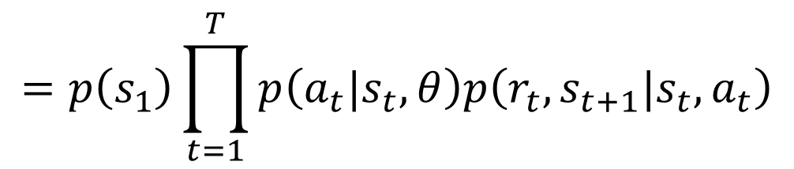
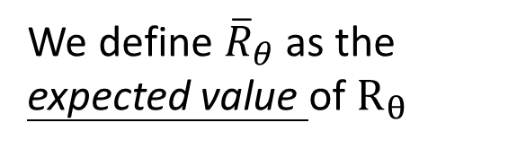
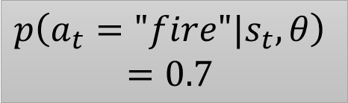
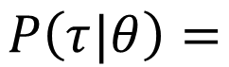
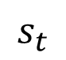
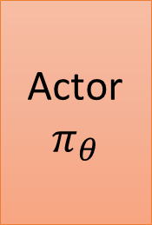
Goodness of Actor
We define ${\overline{R}}_{θ}$ as the expected value of $R_{θ}$
$τ=\left\{s_{1},a_{1},r_{1},s_{2},a_{2},r_{2},⋯,s_{T},a_{T},r_{T}\right\}$
$$P\left(τ|θ\right)=$$
$$p\left(s_{1}\right)p\left(a_{1}|s_{1},θ\right)p\left(r_{1},s_{2}|s_{1},a_{1}\right)p\left(a_{2}|s_{2},θ\right)p\left(r_{2},s_{3}|s_{2},a_{2}\right)⋯$$
$$=p\left(s_{1}\right)\prod_{t=1}^{T}{p\left(a_{t}|s_{t},θ\right)p\left(r_{t},s_{t+1}|s_{t},a_{t}\right)}$$
$$p\left(a_{t}="fire"|s_{t},θ\right)$$
$$=0.7$$
Actor
$$π_{θ}$$
left
0.1
not related to your actor
Control by your actor $π_{θ}$
$$s_{t}$$
right
0.2
fire
0.7

Slide 29
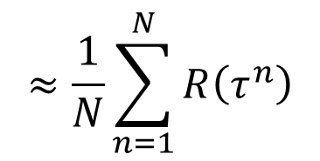
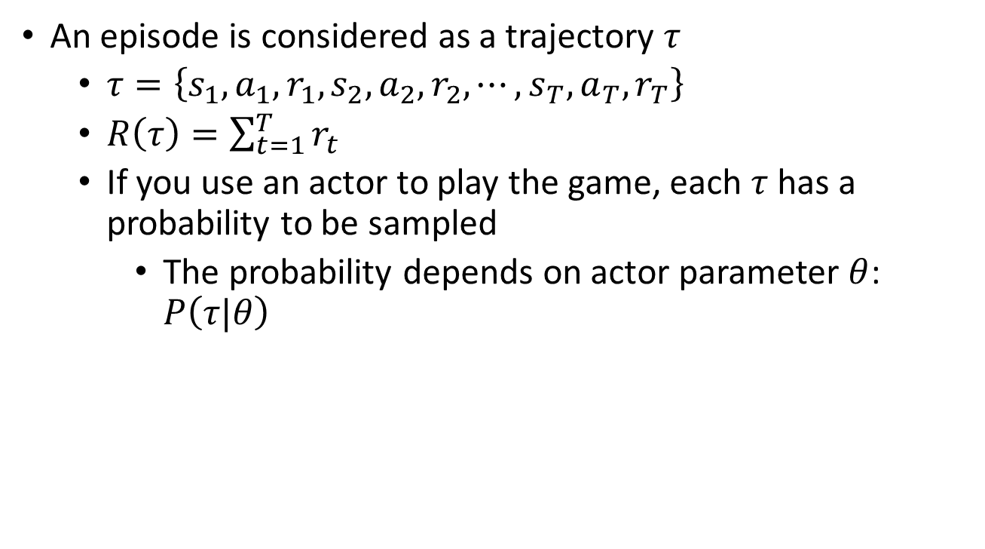
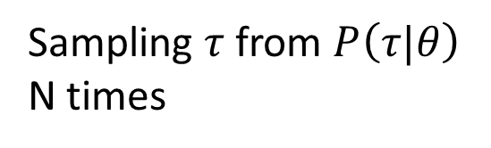
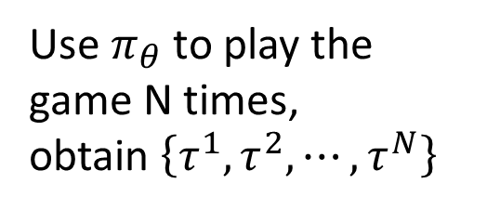
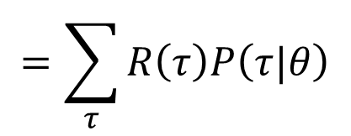
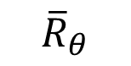
Goodness of Actor
An episode is considered as a trajectory $τ$
$τ=\left\{s_{1},a_{1},r_{1},s_{2},a_{2},r_{2},⋯,s_{T},a_{T},r_{T}\right\}$
$R\left(τ\right)=\sum_{t=1}^{T}{r_{t}}$
If you use an actor to play the game, each $τ$ has a probability to be sampled
The probability depends on actor parameter $θ$: $P\left(τ|θ\right)$
$$=\sum_{τ}{R\left(τ\right)P\left(τ|θ\right)}$$
$$≈\frac{1}{N}\sum_{n=1}^{N}{R\left(τ^{n}\right)}$$
Use $π_{θ}$ to play the game N times,
obtain $\left\{τ^{1},τ^{2},⋯,τ^{N}\right\}$
$${\overline{R}}_{θ}$$
Sum over all possible trajectory
Sampling $τ$ from $P\left(τ|θ\right)$ N times
Notes:
Why don’t we multiple P anymore

Slide 30
Three Steps for Deep Learning
Step 1: define a set of function
Step 2: goodness of function
Step 3: pick the best function
Neural Network as Actor
Deep Learning is so simple ……
Notes:
http://www.twword.com/wiki/%E8%85%A6%E6%88%B6%E7%A9%B4
http://ukenglish.pixnet.net/blog/post/105691160-%E3%80%90%E5%8F%B0%E5%8D%97%E5%B8%82%E5%AD%B8%E8%8B%B1%E8%AA%9E%EF%BC%8C%E5%84%AA%E9%85%B7%E8%8B%B1%E8%AA%9E%E6%96%87%E7%90%86%E5%85%AC%E5%91%8A%E3%80%91%E6%9C%AC%E4%B8%AD%E5%BF%83
http://onepiece1234567890.blogspot.tw/2013/12/blog-post_8.html

Slide 31






Gradient Ascent
Problem statement
Gradient ascent
Start with $θ^{0}$
$θ^{1}←θ^{0}+η∇{\overline{R}}_{θ^{0}}$
$θ^{2}←θ^{1}+η∇{\overline{R}}_{θ^{1}}$
……
$$θ^{∗}=arg\max_{θ}{{\overline{R}}_{θ}}$$
$$θ=\left\{w_{1},w_{2},⋯,b_{1},⋯\right\}$$
$$\left[\begin{aligned}{∂{\overline{R}}_{θ}}/{∂w_{1}} \\ {∂{\overline{R}}_{θ}}/{∂w_{2}} \\ ⋮ \\ {∂{\overline{R}}_{θ}}/{∂b_{1}} \\ ⋮\end{aligned}\right]$$
$$∇{\overline{R}}_{θ}$$
$$=$$
Notes:
Gradient Ascent 梯度上升

Slide 32










Policy Gradient
$$=\sum_{τ}{R\left(τ\right)P\left(τ|θ\right)}$$
$${\overline{R}}_{θ}$$
$$∇{\overline{R}}_{θ}=?$$
$$∇{\overline{R}}_{θ}=\sum_{τ}{R\left(τ\right)∇P\left(τ|θ\right)}$$
$$=\sum_{τ}{R\left(τ\right)P\left(τ|θ\right)\frac{∇P\left(τ|θ\right)}{P\left(τ|θ\right)}}$$
$R\left(τ\right)$ do not have to be differentiable
It can even be a black box.
$$=\sum_{τ}{R\left(τ\right)P\left(τ|θ\right)∇logP\left(τ|θ\right)}$$
$$\frac{dlog\left(f\left(x\right)\right)}{dx}=\frac{1}{f\left(x\right)}\frac{df\left(x\right)}{dx}$$
$$≈\frac{1}{N}\sum_{n=1}^{N}{R\left(τ^{n}\right)∇logP\left(τ^{n}|θ\right)}$$
Use $π_{θ}$to play the game N times,
Obtain $\left\{τ^{1},τ^{2},⋯,τ^{N}\right\}$

Slide 33






Policy Gradient
$$∇logP\left(τ|θ\right)=?$$
$τ=\left\{s_{1},a_{1},r_{1},s_{2},a_{2},r_{2},⋯,s_{T},a_{T},r_{T}\right\}$
$$P\left(τ|θ\right)=p\left(s_{1}\right)\prod_{t=1}^{T}{p\left(a_{t}|s_{t},θ\right)p\left(r_{t},s_{t+1}|s_{t},a_{t}\right)}$$
$$logP\left(τ|θ\right)=logp\left(s_{1}\right)+\sum_{t=1}^{T}{logp\left(a_{t}|s_{t},θ\right)}+logp\left(r_{t},s_{t+1}|s_{t},a_{t}\right)$$
$$∇logP\left(τ|θ\right)=\sum_{t=1}^{T}{∇logp\left(a_{t}|s_{t},θ\right)}$$
Ignore the terms not related to $θ$

Slide 34












Policy Gradient
$$∇logP\left(τ|θ\right)$$
$$=\sum_{t=1}^{T}{∇logp\left(a_{t}|s_{t},θ\right)}$$
$$θ^{new}←θ^{old}+η∇{\overline{R}}_{θ^{old}}$$
$$∇{\overline{R}}_{θ}≈\frac{1}{N}\sum_{n=1}^{N}{R\left(τ^{n}\right)∇logP\left(τ^{n}|θ\right)}$$
$$=\frac{1}{N}\sum_{n=1}^{N}{R\left(τ^{n}\right)\sum_{t=1}^{T_{n}}{∇logp\left(a_{t}^{n}|s_{t}^{n},θ\right)}}$$
$$=\frac{1}{N}\sum_{n=1}^{N}{\sum_{t=1}^{T_{n}}{R\left(τ^{n}\right)∇logp\left(a_{t}^{n}|s_{t}^{n},θ\right)}}$$
What if we replace $R\left(τ^{n}\right)$ with $r_{t}^{n}$ ……
If in $τ^{n}$ machine takes $a_{t}^{n}$ when seeing $s_{t}^{n}$ in
$R\left(τ^{n}\right)$ is positive
Tuning $θ$ to increase $p\left(a_{t}^{n}|s_{t}^{n}\right)$
$R\left(τ^{n}\right)$ is negative
Tuning $θ$ to decrease $p\left(a_{t}^{n}|s_{t}^{n}\right)$
It is very important to consider the cumulative reward $R\left(τ^{n}\right)$ of the whole trajectory $τ^{n}$ instead of immediate reward $r_{t}^{n}$

Slide 35














Policy Gradient
Update
Model
Given actor parameter $θ$
$$τ^{1}:$$
$$\left(s_{1}^{1},a_{1}^{1}\right)$$
$$R\left(τ^{1}\right)$$
$$θ←θ+η∇{\overline{R}}_{θ}$$
$$\left(s_{2}^{1},a_{2}^{1}\right)$$
$$R\left(τ^{1}\right)$$
$$∇{\overline{R}}_{θ}=$$
……
……
$$\frac{1}{N}\sum_{n=1}^{N}{\sum_{t=1}^{T_{n}}{R\left(τ^{n}\right)∇logp\left(a_{t}^{n}|s_{t}^{n},θ\right)}}$$
$$τ^{2}:$$
$$\left(s_{1}^{2},a_{1}^{2}\right)$$
$$R\left(τ^{2}\right)$$
$$\left(s_{2}^{2},a_{2}^{2}\right)$$
$$R\left(τ^{2}\right)$$
……
……
Data
Collection

Slide 36






Policy Gradient
$$−\sum_{i=1}^{3}{{\hat{y}}_{i}logy_{i}}$$
Considered as
Classification Problem
Minimize:
$$y_{i}$$
$${\hat{y}}_{i}$$
left
1
…
right
0
…
s
fire
0
Maximize:
$$logy_{i}=$$
$$logP\left("left"|s\right)$$
$$θ←θ+η∇logP\left("left"|s\right)$$

Slide 37


















Policy Gradient
$$θ←θ+η∇{\overline{R}}_{θ}$$
$$∇{\overline{R}}_{θ}=$$
$$\frac{1}{N}\sum_{n=1}^{N}{\sum_{t=1}^{T_{n}}{R\left(τ^{n}\right)∇logp\left(a_{t}^{n}|s_{t}^{n},θ\right)}}$$
Given actor parameter $θ$
$$τ^{1}:$$
$$\left(s_{1}^{1},a_{1}^{1}\right)$$
$$R\left(τ^{1}\right)$$
$$a_{1}^{1}=left$$
$$\left(s_{2}^{1},a_{2}^{1}\right)$$
$$R\left(τ^{1}\right)$$
NN
left
1
……
……
$$s_{1}^{1}$$
right
0
$$τ^{2}:$$
$$\left(s_{1}^{2},a_{1}^{2}\right)$$
$$R\left(τ^{2}\right)$$
fire
0
$$\left(s_{2}^{2},a_{2}^{2}\right)$$
$$R\left(τ^{2}\right)$$
…
$$a_{1}^{2}=fire$$
NN
left
0
……
……
$$s_{1}^{2}$$
right
0
fire
1

Slide 38







Policy Gradient
$$θ←θ+η∇{\overline{R}}_{θ}$$
$$∇{\overline{R}}_{θ}=$$
$$\frac{1}{N}\sum_{n=1}^{N}{\sum_{t=1}^{T_{n}}{R\left(τ^{n}\right)∇logp\left(a_{t}^{n}|s_{t}^{n},θ\right)}}$$
Given actor parameter $θ$
$$τ^{1}:$$
$$\left(s_{1}^{1},a_{1}^{1}\right)$$
$$R\left(τ^{1}\right)$$
2
Each training data is weighted by $R\left(τ^{n}\right)$
$$\left(s_{2}^{1},a_{2}^{1}\right)$$
$$R\left(τ^{1}\right)$$
2
……
……
$$s_{1}^{1}$$
NN
$$a_{1}^{1}=left$$
$$τ^{2}:$$
$$\left(s_{1}^{2},a_{1}^{2}\right)$$
$$R\left(τ^{2}\right)$$
1
$$\left(s_{2}^{2},a_{2}^{2}\right)$$
$$R\left(τ^{2}\right)$$
$$s_{1}^{1}$$
NN
$$a_{1}^{1}=left$$
1
…
……
……
$$s_{1}^{2}$$
NN
$$a_{1}^{2}=fire$$

Slide 39




Add a Baseline
It is possible that $R\left(τ^{n}\right)$ is always positive.
$$θ^{new}←θ^{old}+η∇{\overline{R}}_{θ^{old}}$$
$$\frac{1}{N}\sum_{n=1}^{N}{\sum_{t=1}^{T_{n}}{\left(R\left(τ^{n}\right)−b\right)∇logp\left(a_{t}^{n}|s_{t}^{n},θ\right)}}$$
$$∇{\overline{R}}_{θ}≈\frac{1}{N}\sum_{n=1}^{N}{\sum_{t=1}^{T_{n}}{R\left(τ^{n}\right)∇logp\left(a_{t}^{n}|s_{t}^{n},θ\right)}}$$
It is probability …
Ideal
case
a
b
c
a
b
c
Not sampled
The probability of the actions not sampled will decrease.
Sampling
……
a
b
c
a
b
c

Slide 40
Value-based Approach
Learning a Critic
Notes:
Double Q
Duel Q

Slide 41



Critic
A critic does not determine the action.
Given an actor $π$, it evaluates the how good the actor is
An actor can be found from a critic.
e.g. Q-learning
http://combiboilersleeds.com/picaso/critics/critics-4.html

Slide 42







Critic
State value function $V^{π}\left(s\right)$
When using actor $π$, the cumulated reward expects to be obtained after seeing observation (state) s
$$V^{π}$$
$$V^{π}\left(s\right)$$
s
scalar
$V^{π}\left(s\right)$ is large
$V^{π}\left(s\right)$ is smaller
Notes:
(Lots of aliens to be killed, and the shields still exist)

Slide 43




Critic
$$V^{以前的阿光}\left(大馬步飛\right)=bad$$
$$V^{變強的阿光}\left(大馬步飛\right)=good$$
Notes:
http://combiboilersleeds.com/picaso/critics/critics-4.html

Slide 44














How to estimate $V^{π}\left(s\right)$
Monte-Carlo based approach
The critic watches $π$ playing the game
After seeing $s_{a}$,
$$V^{π}$$
Until the end of the episode, the cumulated reward is $G_{a}$
$$s_{a}$$
$$V^{π}\left(s_{a}\right)$$
$G_{a}$
After seeing $s_{b}$,
$$V^{π}$$
Until the end of the episode, the cumulated reward is $G_{b}$
$$s_{b}$$
$$V^{π}\left(s_{b} \right)$$
$G_{b}$

Slide 45










How to estimate $V^{π}\left(s\right)$
Temporal-difference approach
$$⋯s_{t},a_{t},r_{t},s_{t+1}⋯$$
$$V^{π}$$
$$V^{π}\left(s_{t}\right)+r_{t}=V^{π}\left(s_{t+1} \right)$$
$$s_{t}$$
$$V^{π}\left(s_{t}\right)$$
-
$$V^{π}\left(s_{t}\right)−V^{π}\left(s_{t+1}\right)$$
$$r_{t}$$
$$V^{π}$$
$$s_{t+1}$$
$$V^{π}\left(s_{t+1}\right)$$
Some applications have very long episodes, so that delaying all learning until an episode's end is too slow.
Notes:
The next most obvious advantage of TD methods over Monte Carlo methods is
that they are naturally implemented in an on-line, fully incremental fashion. With
Monte Carlo methods one must wait until the end of an episode, because only then
is the return known, whereas with TD methods one need wait only one time step.
Surprisingly often this turns out to be a critical consideration Other applications are continuing tasks and have no episodes at all.

Slide 46










MC v.s. TD
…
$$V^{π}$$
Larger variance
$$s_{a}$$
$$V^{π}\left(s_{a}\right)$$
$G_{a}$
unbiased
$$V^{π}$$
$$V^{π}$$
$$s_{t}$$
$$V^{π}\left(s_{t}\right)$$
$$r+$$
$$V^{π}\left(s_{t+1}\right)$$
$$s_{t+1}$$
Smaller variance
May be biased

Slide 47





MC v.s. TD
[Sutton, v2, Example 6.4]
The critic has the following 8 episodes
$s_{a},r=0,s_{b},r=0$, END
$s_{b},r=1$, END
$s_{b},r=1$, END
$s_{b},r=1$, END
$s_{b},r=1$, END
$s_{b},r=1$, END
$s_{b},r=1$, END
$s_{b},r=0$, END
$$V^{π}\left(s_{b}\right)=3/4$$
$$V^{π}\left(s_{a}\right)=?$$
0?
3/4?
Monte-Carlo:
$$V^{π}\left(s_{a}\right)=0$$
Temporal-difference:
$$V^{π}\left(s_{b}\right)+r=V^{π}\left(s_{a}\right)$$
3/4
0
3/4
(The actions are ignored here.)

Slide 48







Another Critic
State-action value function $Q^{π}\left(s,a\right)$
When using actor $π$, the cumulated reward expects to be obtained after seeing observation s and taking a
$$Q^{π}$$
$$Q^{π}$$
$$Q^{π}\left(s,a=left\right)$$
s
$$Q^{π}\left(s,a\right)$$
s
$$Q^{π}\left(s,a=right\right)$$
scalar
a
$$Q^{π}\left(s,a=fire\right)$$
for discrete action only

Slide 49

Q-Learning
$π$ interacts with the environment
𝜋 interacts with the environment
Learning $Q^{π}\left(s,a\right)$
Learning 𝑄^𝜋 (𝑠,𝑎)
Find a new actor $π^{′}$ “better” than $π$
Find a new actor 𝜋^′ “better” than 𝜋
$$π=π^{′}$$
TD or MC
?
Notes:
Add some noise

Slide 50



Q-Learning
Given $Q^{π}\left(s,a\right)$, find a new actor $π^{′}$ “better” than $π$
“Better”: $V^{π^{′}}\left(s\right)≥V^{π}\left(s\right)$, for all state s
$$π^{′}\left(s\right)=arg\max_{a}{Q^{π}\left(s,a\right)}$$
$π^{′}$ does not have extra parameters. It depends on Q
Not suitable for continuous action a

Slide 51
Deep Reinforcement Learning
Actor-Critic
Notes:
Critically, the agent uses the value estimate (the critic) to update the policy (the actor) more intelligently than traditional policy gradient methods.

Slide 52
Actor-Critic
$π$ interacts with the environment
𝜋 interacts with the environment
Learning $Q^{π}\left(s,a\right), V^{π}\left(s\right)$
Learning 𝑄^𝜋 (𝑠,𝑎), 𝑉^𝜋 (𝑠)
Update actor from $π→π’$ based on $Q^{π}\left(s,a\right), V^{π}\left(s\right)$
Update actor from 𝜋→𝜋’ based on 𝑄^𝜋 (𝑠,𝑎), 𝑉^𝜋 (𝑠)
$$π=π^{′}$$
TD or MC

Slide 53



Actor-Critic
Tips
The parameters of actor $π\left(s\right)$ and critic $V^{π}\left(s\right)$ can be shared
Network
left
Network
right
$$s$$
fire
Network
$$V^{π}\left(s\right)$$

Slide 54








Asynchronous
Source of image: https://medium.com/emergent-future/simple-reinforcement-learning-with-tensorflow-part-8-asynchronous-actor-critic-agents-a3c-c88f72a5e9f2#.68x6na7o9
$$θ^{1}$$
$$+η∆θ$$
$$θ^{2}$$
1. Copy global parameters
(other workers also update models)
2. Sampling some data
$$∆θ$$
3. Compute gradients
$$θ^{1}$$
4. Update global models
$$θ^{1}$$
$$∆θ$$
Notes:
李思叡

Slide 55

Demo of A3C
https://www.youtube.com/watch?v=0xo1Ldx3L5Q
Racing Car (DeepMind)

Slide 56
Demo of A3C
Visual Doom AI Competition @ CIG 2016
https://www.youtube.com/watch?v=94EPSjQH38Y

Slide 57
Concluding Remarks
Model-free Approach
Policy-based
Value-based
Learning an Actor
Actor + Critic
Learning a Critic
Model-based Approach
Notes:
Alpha Go: policy-based + value-based + model-based

